Slide 1
AP Statistics
Section 7.1 Continuous
Random Variables

Slide 2
What is a Random variable?
This section is about how to combine the mean and standard deviation of two or more random variables:
A variable is a value that has variation, can take on a range of values
In statistics, a “random variable” is a variable that can take on a range of numerical values as a result of random events.
  Weight of an egg, how much money you win/lose, number of sales, amount of coffee dispensed,
These outcomes of a random variable can have a “distribution” – normal, skewed, uniform, …. whatever…
We will use letters “X”, “Y”, or “Z” to represent these random variables
Random variables can be classified into two main types: “Discrete” OR “Continuous”

Slide 3
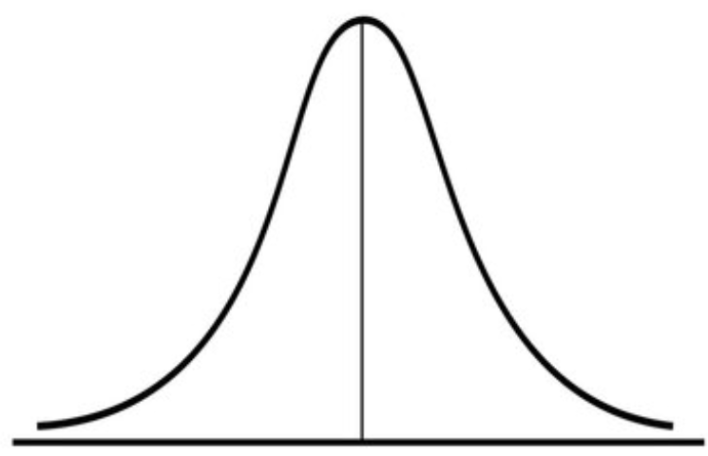
Example of Random Variables:
This section is about how to combine the mean and standard deviation of two more more “Random Variables”
Ie: Suppose the mean weight of an egg is 20g with a standard deviation of 2.3g, and the mean weight of a basket is 5lbs with a standard deviation of 1.2lbs. What is the mean weight and standard deviation of one basket with 12eggs? Is there a way to find the probability that the total weight is more than 3000 grams?
1. The weight of One egg is normally distributed
2. The weight of one basket is from another distribution
Another challenge is that the units for the basket’s weight is in pounds/eggs are in grams.
We need to convert the units into grams, how will this affect the weight distribution? Mean? Std Dev?
So what if we had 12 eggs? How would the distribution of weight of 12 eggs be affected??
Overall, the goal of this section is to combine all these “Random Variables” and then find the mean/std dev. of the weight distribution of 12eggs + basket
How to find the Mean & Std Dev of 12 eggs? Dev?

Slide 4
Discrete and Continuous Random Variables
A random variables can be discrete or continuous:
  Discrete: The number of people in your family: X=0,1,2,3,4,5….
  Continuous: How long have you been alive: 0 < X < 40 years
Discrete Random Variables take on a fixed set of possible values (integers only) but not the values in between [not continuous]
  Ie: Whole numbers, integers, how many people, number of fingers
Continuous Random Variable can on take on all values in between an interval (decimals, irrational values)
  Decimals, continuous decimal values not restricted by increments
  Ie: Weight, height, time, [values that don’t need to be whole numbers are continuous]

Slide 5
Ex: Define the random variable in each event. Indicate discrete or continuous:
i) Flip a coin 4 times & count the number of heads
“X” : The number of heads in 4 coin toss:
X is Discrete because it can only be integers: {0,1,2,3,4}
ii) Time it takes to cook a cup of noodles, μ=5min std dev: 1.2min
“X” : The amount of time to cook a cup of noodles in minutes. X is continuous because it can be anytime from 0 to as however long you want to cook your noodles for
iii) Number of kids until you get a girl or 4th child
“X” : The number of kids you have until you get a girl or 4 kids
X is discrete because it can only be integers: {1,2,3,4}
iv) Wait time for your spouse to leave the house before going to dinner μ=35.8min std dev.=10.5min
“X” : The amount of time you wait for your spouse
X is continuous because it can be any amount of time from 0 to infinity….

Slide 6
Suppose you have two eggs, each egg has a mean weight of 20g and a standard deviation of 2.3g. What is the Mean weight for the distribution of 2 eggs combined? Assume that weight of eggs are normally distributed.
Rule #1: When two random variables are added together, the “mean for their sum” is equal to the sum of their “means”
Weight Distribution of 2 Eggs
The mean weight of 1 egg is 20g, so the mean weight of 2 eggs would be:
Suppose the combined weight of two eggs is normally distributed, the mean of this distribution would be 40g
Likewise the mean weight of 12 eggs would be the sum of the 12 means:
Weight Distribution of 12 Eggs
Suppose the combined weight of twelve eggs is normally distributed, the mean of this distribution would be 240g

Slide 7
The mean weight of a grade 12 student is 160lbs and the mean weight of a grade 11 student is 140lbs. Suppose we want to know the difference in weight between gr11 and 12 students. What is the mean of the “difference in weight”?
Rule #2: When subtracting two random variables, “mean” for the distribution of the difference is equal to the difference of the two means.
Suppose “X” is the random variable for the mean weight of a gr11 student:
Distribution of Difference in Weights between Gr12 & Gr11 Students
Suppose “Y” is the random variable for the mean weight of a gr12 student:
Now let “Z” be the difference in weight between gr 11 and gr12 students

Slide 8
Suppose you have two eggs, each egg has a mean weight of 20g and a standard deviation of 2.3g. How would you find the standard deviation of weight for 2 eggs combined?
Rule #3: Can’t combine standard deviations. Instead, combine the variance!
Instead, we can only combine variances. After we have variance, square root to find the standard deviation:
Suppose the combined weight of two eggs is normally distributed, one std dev. of this distribution would be around 3.253g
NO!!! Can’t combine standard deviations!!
Standard deviation of 2 eggs
Likewise, if we want to find the standard deviation of weight for 12 eggs, find the variance first. The Square root to get the standard deviation

Slide 9
The mean weight of a grade 12 student is 160lbs with std deviation of 8lbs. The mean weight of a grade 11 student is 140lbs with std deviation of 6lbs. What is the standard deviation in the “difference in weight” between the two grades?
Rule #4: It doesn’t matter whether you are Adding or Subtracting two random variables, you always ADD their variance.
Ie: The variance of the difference in weight between the two grades is the sum of the variance of each grade
Now let “Z” be the difference in weight between gr 11 and gr12 students
Remember TWO things:
1. You always “ADD” the variance
2. To find standard deviation, you must find variance first!
the standard deviation of the difference is 10lbs

Slide 10
Rule #3 & #4: It doesn’t matter whether you are Adding or Subtracting two random variables, you always ADD their variance
Random Variables “A”, “B”, and “C” MUST be independent!!!
Always add the sum of the variance!!

Slide 11
Ex: An Ambrosio apple has a mean weight of 215g with a std dev of 25g. A navel orange has a mean weight of 140g with a std dev of 20g. Suppose I want to buy 2 Ambrosio apples and 3 navel oranges.
i) What is the mean of the total weight?
ii) What is the standard deviation of the total weight?
iii) What is the probability that the total weight is more than 900g?

Slide 12
Suppose the mean temperature of an oven is 340 Fahrenheit, what is the mean temperature of the oven is Celsius?
Rule #5: When converting the units of measurement of a random variable using a linear equation, convert the mean using the same equation
Often when converting units, the linear equation will have a Y-intercept of zero.

Slide 13
Suppose the mean temperature of an oven is 340 Fahrenheit with a standard deviation of 10Fahrenheit, what is the standard deviation of temperature change in Celsius?
Rule #6: When converting random variables using a linear equation, you can convert the standard deviation directly by multiplying the slope OR find the variance by multiplying by the (slope)²
When converting standard deviations, only the “slope” is required. You don’t need the “y-intercept”

Slide 14
Jim works as a salesman in a car dealership. Each month he sells an average of 20 cars with a standard deviation of 3.5 cars. He earns a commission of $300 per car plus a base salary of $1200 a month.
a) What is Jim’s mean monthly salary?
b) What is the standard deviation of Jim’s monthly salary?
c) Suppose Jim’s monthly salary is normally distributed. What is the probability that Jim will earn between $6000 to $7800 this month?

Slide 15
Summary of what we have discussed so far:
Suppose “a”, “b” “c”, and “d” are just constants
Mean
Mean
Variance
Variance
Standard Deviation
Std Dev:
“X” “Y” & “Z” must be independent!!!!

Slide 16
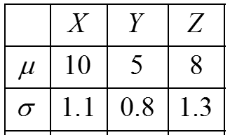
Given the random variables “x”, “y”, and “z” with the mean and stand dev., calculate the mean and std dev. for random variables “F” , “T” and “W”
Random variables “Y” & “Z” must be independent!!!!
Random variable F
Random variable T
Random variable W
Mean:
Var:
Std Dev:

Slide 17
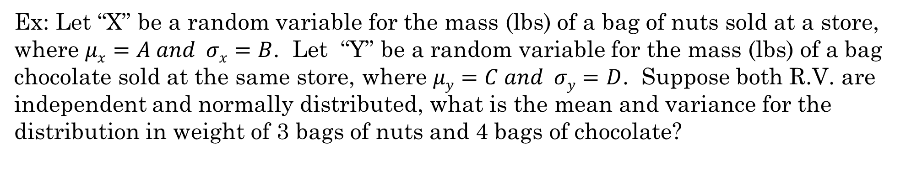
Ex: Let “X” be a random variable for the mass (lbs) of a bag of nuts sold at a store, where $μx=A and σx=B$. Let “Y” be a random variable for the mass (lbs) of a bag chocolate sold at the same store, where $μy=C and σy=D$. Suppose both R.V. are independent and normally distributed, what is the mean and variance for the distribution in weight of 3 bags of nuts and 4 bags of chocolate?

Slide 18
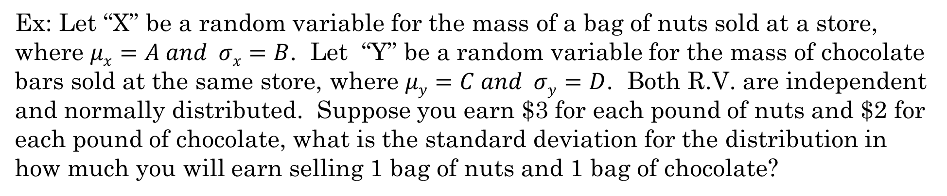
Ex: Let “X” be a random variable for the mass of a bag of nuts sold at a store, where $μx=A and σx=B$. Let “Y” be a random variable for the mass of chocolate bars sold at the same store, where $μy=C and σy=D$. Both R.V. are independent and normally distributed. Suppose you earn $3 for each pound of nuts and $2 for each pound of chocolate, what is the standard deviation for the distribution in how much you will earn selling 1 bag of nuts and 1 bag of chocolate?

Slide 19
EX: Suppose the mean weight of an egg is 20g with a std. dev. of 2.3g, and the mean weight of a basket is 5lbs with a std dev. of 1.2lbs. What is the mean weight and std dev. of one basket with 12eggs?
Let’s start with finding the mean and std dev. Of the distribution for 12 eggs:
The mean weight for the distribution of one egg is 20g. So the mean for the distribution of 12 eggs will be:
The std dev. for the distribution of weights for 12 eggs will be:
Next we need to convert the weight of the basket from lbs to grams
Now get the mean and weight for everything: basket + 12 eggs:

Slide 20
What is the probability that the total weight is more than 3000grams?
Conditions for using a normal distribution:
1. Each of the random variables are Independent of one another
The weight of each egg is independent of each other is it came from different chickens. The weight of the basket is independent from the eggs.
2. Each random variable comes from a normal distribution
The eggs and basket are all normally distributed

Slide 21
Ex: (Rule 1) Suppose the temperature (Celsius) for that last 4 days were: 25^{ο}, 28^{ο}, 29^{ο}, 32^{ο}. Find the average temperate in Celsius and Fahrenheit. The conversion from Celsius to Fahrenheit is:
Ex: Suppose the equation Y=20 + 100X converts a PSAT math score, X, into an SAT math score, Y. Suppose the average PSAT math score is 48. What is the average SAT math score?
b) Suppose the standard deviation for the PSAT math score is 1.5 points. What is the standard deviation for the SAT math score?

Slide 22
Ex: (Rule 1) Suppose the temperature (Celsius) for that last 4 days were: 25^{ο}, 28^{ο}, 29^{ο}, 32^{ο}. Find the average temperate in Celsius and Fahrenheit. The conversion from Celsius to Fahrenheit is:
Using Rule #1, we can find the
average of the degrees in Fahrenheit:
Check your answer by converting the temperatures into Fahrenheit:

Slide 23
Ex: Suppose the equation Y=20 + 100X converts a PSAT math score, X, into an SAT math score, Y. Suppose the average PSAT math score is 48. What is the average SAT math score?
b) Suppose the standard deviation for the PSAT math score is 1.5 points. What is the standard deviation for the SAT math score?
Variance for the PSAT math score
Standard deviation for SAT math score

Slide 24
Ex: Suppose the test scores of Math students in grade 11 are normally distributed with a mean score of 78 points and standard deviation of 9 points. Teacher “A” randomly took a student and multiplied their score by 5. Teacher “B” randomly selected 5 students and took the sum of their scores.
a) Which teacher will have a greater expected value?
b) Which teacher will have a greater standard deviation?
c) What is the probability that the total score created by each teacher is greater than 400?

Slide 25
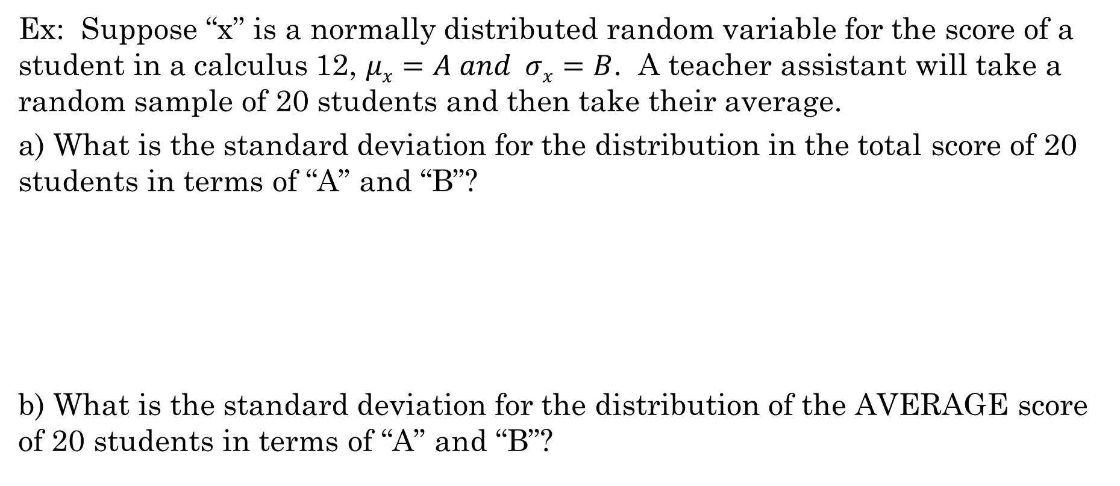
Ex: Suppose “x” is a normally distributed random variable for the score of a student in a calculus 12, $μx=A and σx=B$. A teacher assistant will take a random sample of 20 students and then take their average.
a) What is the standard deviation for the distribution in the total score of 20 students in terms of “A” and “B”?
b) What is the standard deviation for the distribution of the AVERAGE score of 20 students in terms of “A” and “B”?

